Slide 1

Camera-Based Canal water Monitoring Using Deep Learning and Computer Vision
Presenter: Atif Latif, Talha Shahzad
December 3, 2025
1

Slide 2
Introduction
AI and modern computing are transforming hydrologic monitoring by enabling real-time measurement of water levels, flow, and channel width.
Problem Statement
Traditional hydrologic methods have limitations that reduce scalability, increase maintenance needs, and hinder long-term deployment in remote areas.
Motivation
Camera-based monitoring has emerged as a cost-effective, scalable approach that provides continuous, high-temporal-resolution data for streams and rivers.
Two main camera-based techniques:
Visual gaging: Estimates stage height using visible reference markings, but requires stable, clearly visible fixed structures.
Semantic segmentation: Deep learning models identify water surfaces/pixels directly, allowing generalization across environments.
5

Slide 3
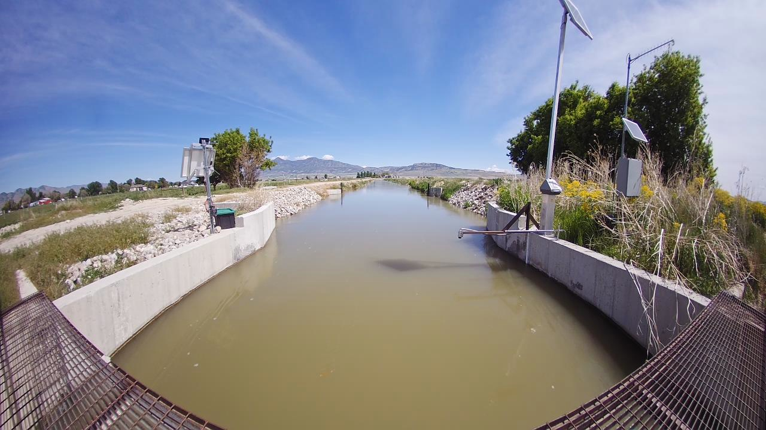
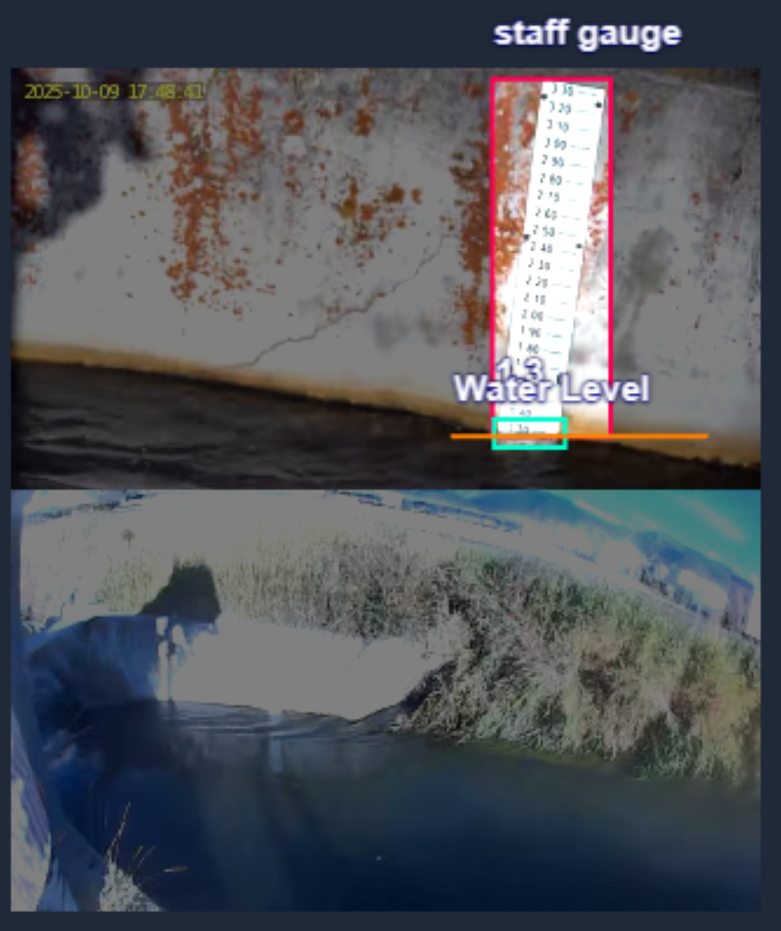
Methodology (Overview)
Data Collection
Fielding Bear Canal
Geovision Cameras (GV-GBL12811)
Raspberry PI 5
Data Collected from April to September
Types of Data: Visual/ Virtual images
Images labeled manually using Roboflow for visual guage
Figure 1: Data sample for virtual gauge
Data | Virtual Gauge | Visual Gauge
Training | 186 | 213
Testing | 40 | 24
Validation | 39 | 24
Table 1: Dataset split
Figure 2: Labeled sample for visual gauge
7

Slide 4
Methodology (Visual Guage)
Label dataset in Roboflow: Guage, Level, Digits
Export in YOLOv8 format
Use uniform settings: 640×640, 200 epochs, augmentations
Train three models: YOLOv8n, YOLOv8s, YOLOv8l
YOLOv8n (Nano): Fastest, smallest
YOLOv8s (Small): Balanced, best generalization
YOLOv8l (Large): Highest capacity but prone to overfitting
Evaluate on validation + test sets
Select best-performing model
Model | Input Size (pixels) | mAPval 50-95 | Speed CPU ONNX (ms) | Speed A100 TensorRT (ms) | Params (M) | FLOPs (B)
YOLOv8n | 640 | 37.3 | 80.4 | 0.99 | 3.2 | 8.7
YOLOv8s | 640 | 44.9 | 128.4 | 1.20 | 11.2 | 28.6
YOLOv8m | 640 | 50.2 | 234.7 | 1.83 | 25.9 | 78.9
YOLOv8l | 640 | 52.9 | 375.2 | 2.39 | 43.7 | 165.2
YOLOv8x | 640 | 53.9 | 479.1 | 3.53 | 68.2 | 257.8
Table 2: Yolov8 Matrices on Common Objects in Context (COCO) Dataset
8

Slide 5
Methodology (Virtual Guage)
Data Preparation
Water boundary annotated in Roboflow and exported for PyTorch
Augmentations: brightness ±20%, random crop 80–100%
Preprocessing: resize to 512×512 or 640×640, normalize to [0,1]
Gaussian blur (3×3) and histogram equalization applied for contrast
Split: 70% train, 15% validation, 15% test
Metrics: IoU, Dice, Pixel Accuracy for validation
7

Slide 6
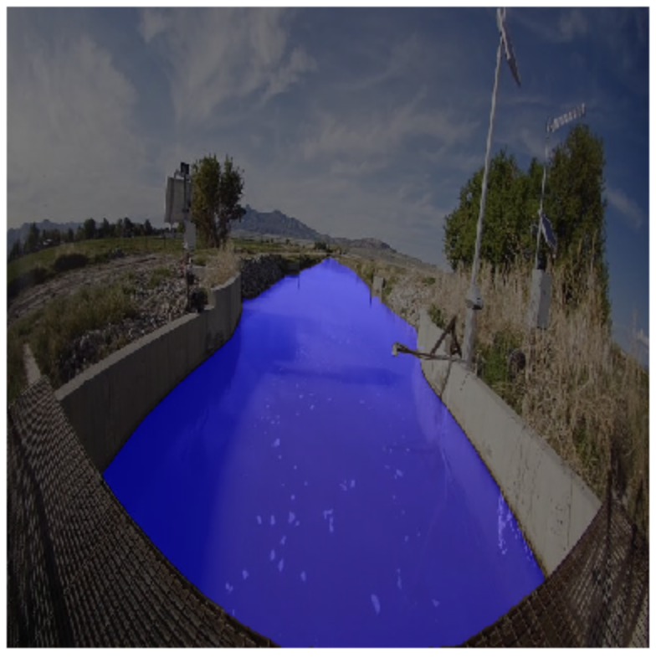
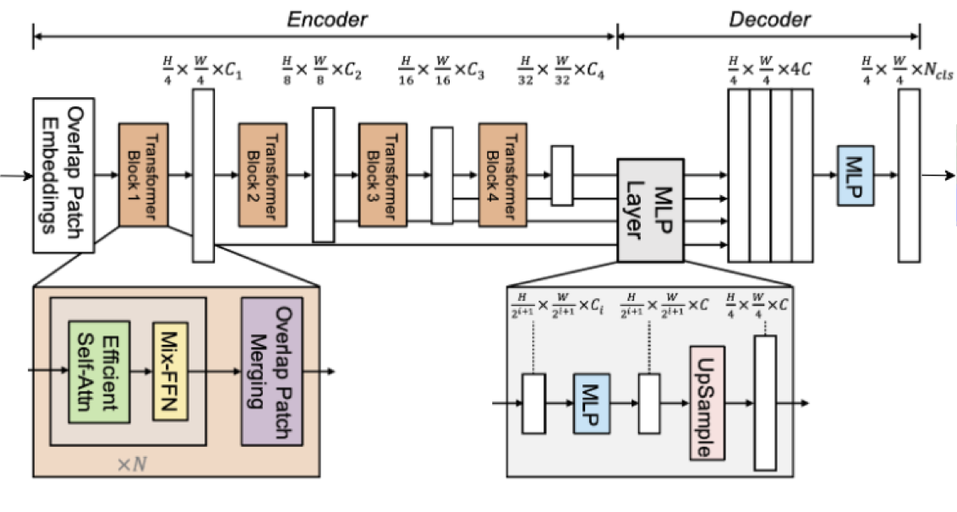
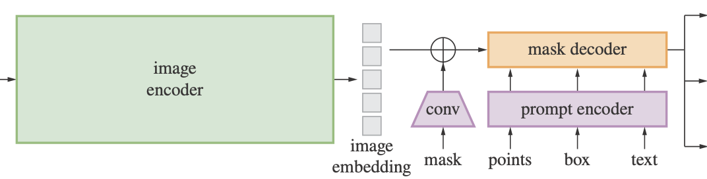
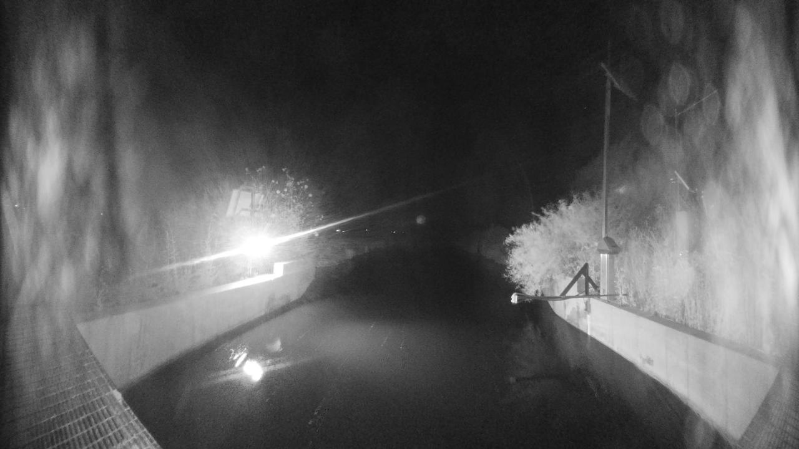
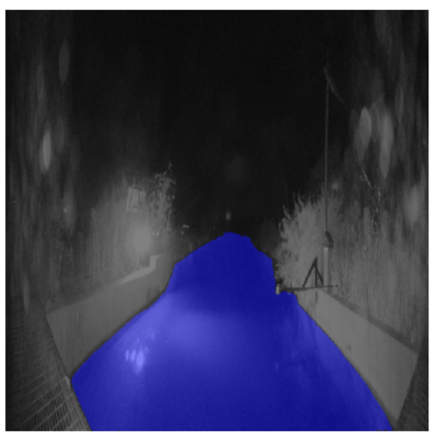
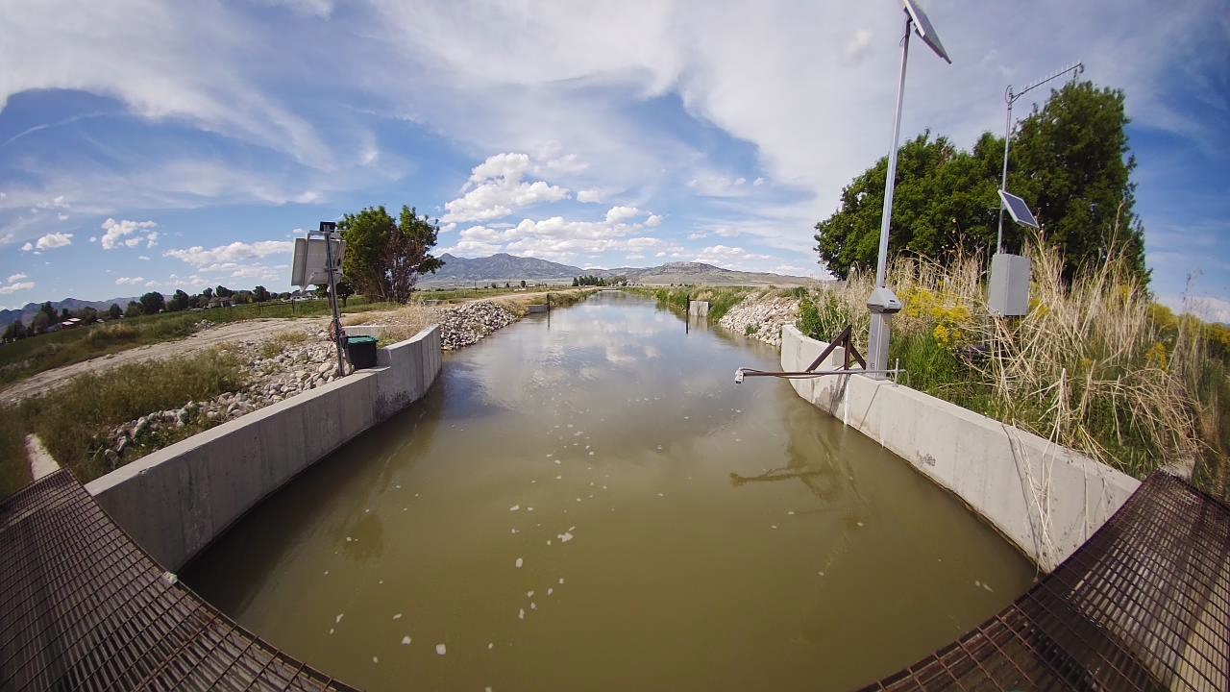
Methodology (Virtual Guage)
Figure. 3: Model Architecture of SAM
Figure. 4: Model Architecture of SegFormer
Feature | SegFormer | SAM
Core Type | Hierarchical Transformer + MLP Decoder | Prompt-based Transformer with Mask Decoder
Encoder | 4-stage transformer encoder (MiT) | Vision Transformer (ViT-H/B/L)
Decoder | Simple MLP Decoder | Mask Decoder integrating prompt/ image tokens
Training Type | Supervised semantic segmentation | Foundation model (pre-trained, zero-shot
Use Case | Efficient semantic segmentation on general platforms | General-purpose segmentation across domains
Table 3: SAM vs SegFormer
8
Notes:
SegFormer is a transformer-based semantic segmentation model designed to be both lightweight and highly efficient.
The architecture contains four hierarchical transformer encoder stages, each processing the image at progressively lower resolutions.
Each encoder stage uses:
Overlapping patch embeddings
Attention-based transformer blocks
These help capture local details and global context simultaneously.
The model generates multi-scale feature representations, which are passed to the decoder.
The decoder uses MLPs and upsampling to convert features into dense per-pixel class predictions.
This design reduces computational cost compared to traditional CNN-based models.
Well-suited for edge deployment due to its efficiency and low memory footprint.
Overall, SegFormer provides accurate segmentation with minimal computational resources, making it ideal for real-time environmental monitoring tasks.
SAM (Segment Anything Model) by Meta AI is a major advancement in segmentation using a prompt-driven, zero-shot framework.
It can segment a wide variety of objects without task-specific training, making it ideal for real-world, dynamic environments.
The architecture includes three main components:
Image Encoder: A Vision Transformer (ViT) that produces dense visual embeddings.
Prompt Encoder: Processes prompts such as points, boxes, or text.
Mask Decoder: Combines image and prompt embeddings to generate the segmentation mask.
Core operation:
M = Decoder(Encoder(I), P)
SAM supports flexible prompting, enabling interactive and automated segmentation.
Its zero-shot generalization, modularity, and efficiency make it suitable for edge devices or cloud-based pipelines.
Ideal for applications requiring fast, adaptable segmentation without retraining.

Slide 7
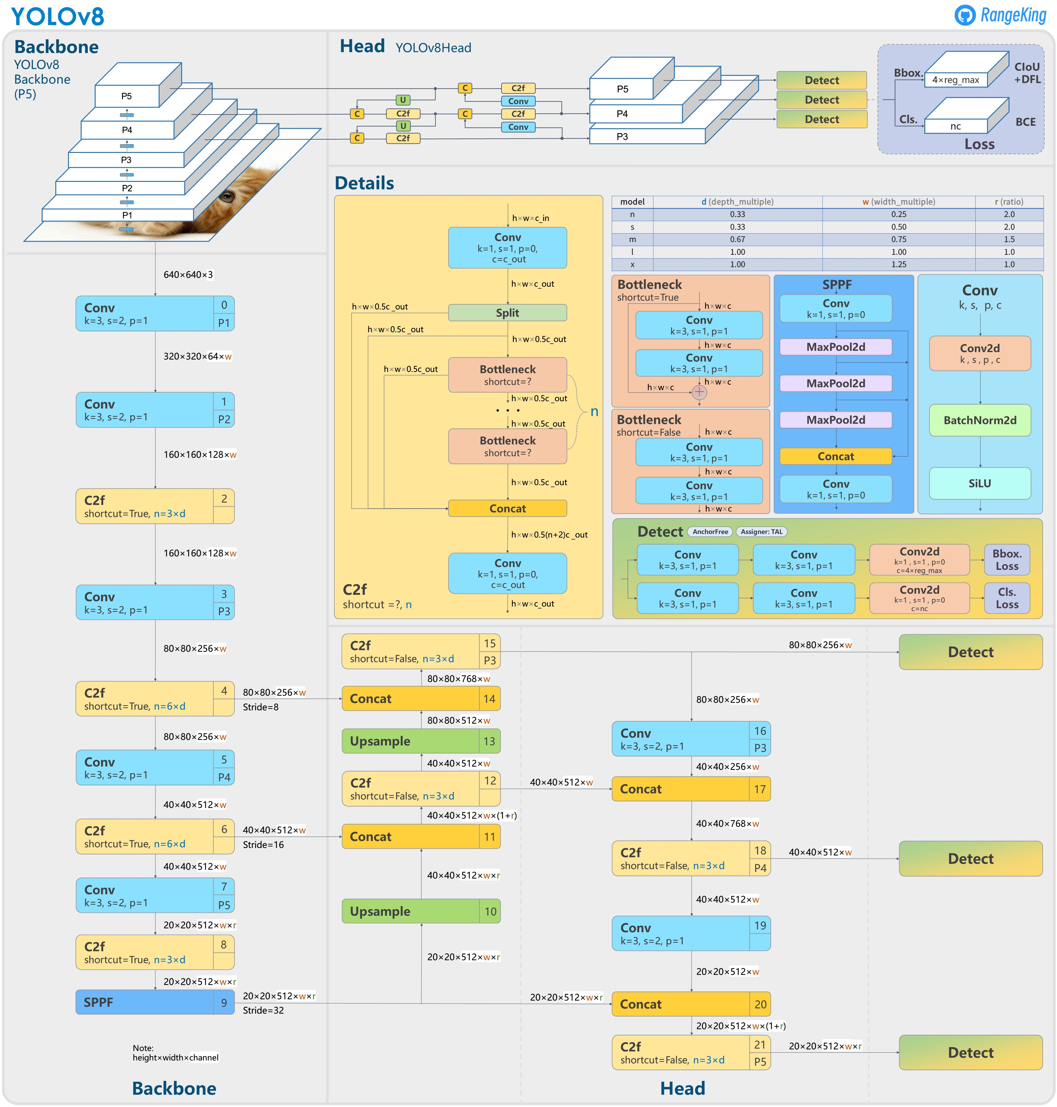
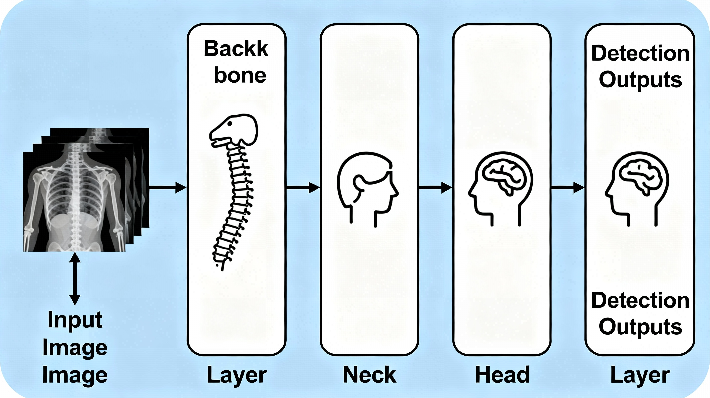
Model Architecture (Visual Guage)
Backbone: CSPDarknet-style CNN with C2f modules for feature extraction at multiple scales.​
Neck: PAN/feature fusion part (often including SPPF and C2f blocks) to aggregate multi‑scale features.​
Head: Anchor‑free, split Ultralytics detection head that outputs classes and box regression at three scales.
Figure 5: Simplified YOLOv8 Architecture
Figure 6: Detailed YOLOv8 Architecture
8

Slide 8
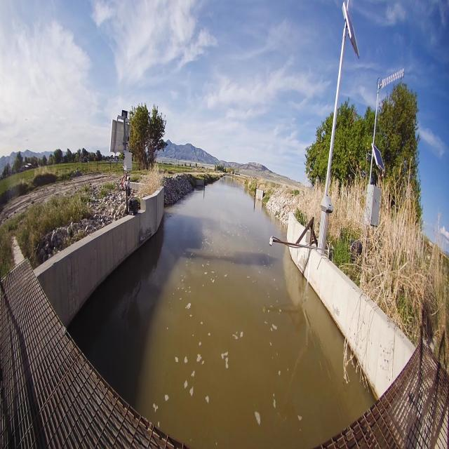
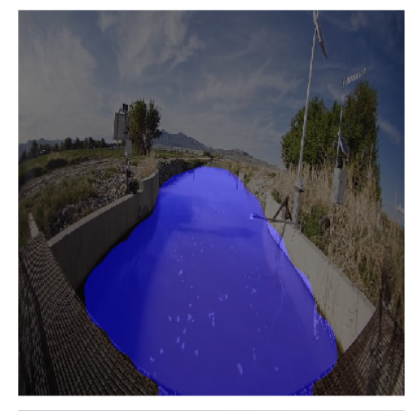
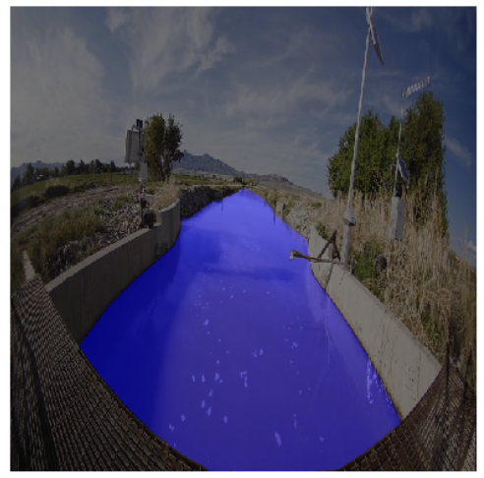
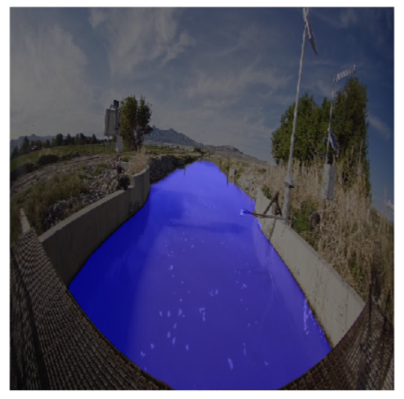

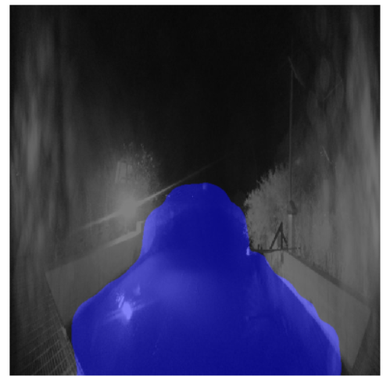
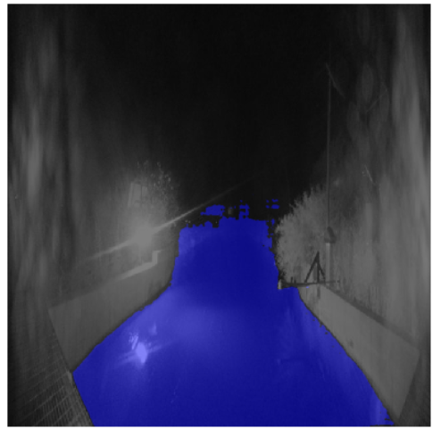
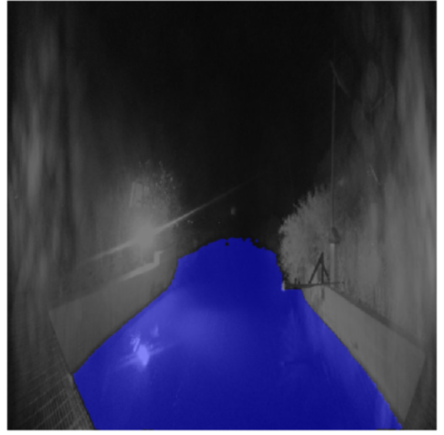
Experimentation (Virtual Guage)
Original SegFormer SAM MobileSAM
Figure 7: Representative segmentation results at Fielding site during day and night
10

Slide 9
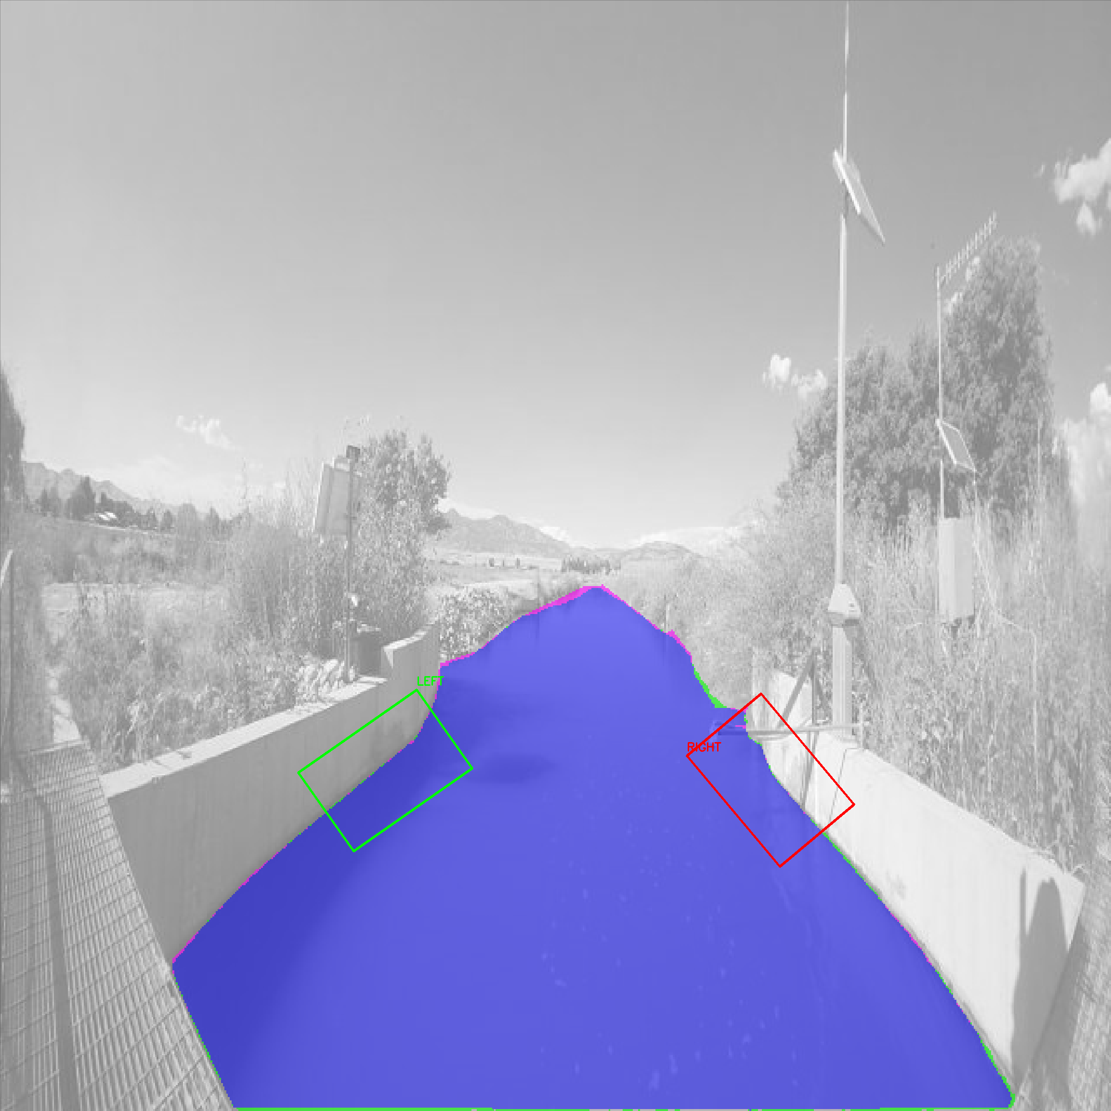
Experimentation (Virtual Guage)
Figure 8: Examples of segmentation masks with ROI overlays
10

Slide 10
Experimental Setup (Visual Guage)
Train/valid/test splits used for robust evaluation.
Augmented Data added to training
Hardware:
CPU-only (local machine): YOLOv8n and YOLOv8s
Colab T4 GPU: YOLOv8l
Evaluation uses YOLOv8's built-in validation pipeline.
Data Augmentations
Rotation: Between -15° and +15°
Shear: ±10° Horizontal, ±10° Vertical
Brightness: Between -15% and +15%
Exposure: Between -10% and +10%
Noise: Up to 0.1% of pixels
10

Slide 11
Evaluation Metrics (Virtual Guage)
Accuracy
Proportion of correctly classified pixels: Accuracy = (TP + TN) / (TP + TN + FP + FN)
F1 Score / Dice Coefficient
Harmonic mean of precision and recall: F1 = 2 × (Precision × Recall) / (Precision + Recall)
Intersection over Union (IoU)
Spatial overlap between prediction and ground truth: IoU = TP / (TP + FP + FN)
Cohen’s Kappa
Agreement beyond chance: κ = (po − pe) / (1 − pe)
where po is the observed agreement and pe is the expected agreement by chance.
10

Slide 12
Evaluation Metrics (Virtual Guage)
Missed Alarm Rate (MAR): average area of segmented water pixels within predefined trapezoidal regions of interest (ROIs) across time-series images. This metric reflects model stability in capturing consistent water extents over time.
False Alarm Rate (FAR): the proportion of false positives (non-water predicted as water) relative to total image area:FAR helped distinguish between accurate and overly generous segmentations, particularly in field conditions with variable backgrounds
10

Slide 13
Evaluation Metrics (Visual Guage)
Precision Measures how accurate the model’s positive predictions are. Precision = TP / (TP + FP) High precision → few false alarms (model rarely predicts wrong labels). | Recall Measures how well the model finds all real objects. Recall = TP / (TP + FN) High recall → model detects most gauge numbers and water levels.
mAP@0.5 IoU threshold = 0.5 A lenient metric. Measures “did the model detect it roughly correctly?” | mAP@0.5:0.95 Average mAP over IoU = 0.5 to 0.95 (step 0.05). Much stricter. Measures both detection accuracy and box quality.
Fitness (internal YOLO metric): A weighted combination of evaluation metrics used to select the best model checkpoint — not used for official evaluation.
10

Slide 14
Results (Virtual Guage)
Metric | SegFormer | MobileSAM | SAM
Accuracy | 0.98 | 0.99 | 0.99
Precision | 0.94 | 0.99 | 0.98
Recall | 0.99 | 0.98 | 0.99
F1 Score | 0.96 | 0.98 | 0.99
IoU | 0.93 | 0.97 | 0.98
Dice Score | 0.96 | 0.98 | 0.99
Kappa | 0.95 | 0.98 | 0.98
False Pos. | 5916 | 925 | 1112
False Neg. | 954 | 1825 | 732
Table 4: Comparison of segmentation performance
11

Slide 15
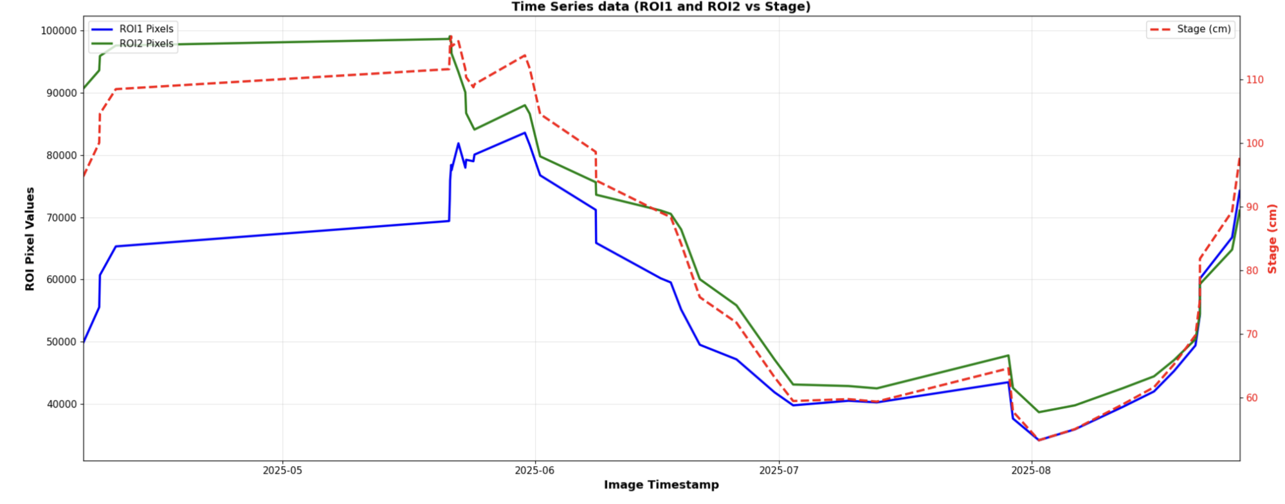
Results (Virtual Guage)
Figure 9: Time series of ROI1 and ROI2 pixel counts with Bear canal stage height
12

Slide 16
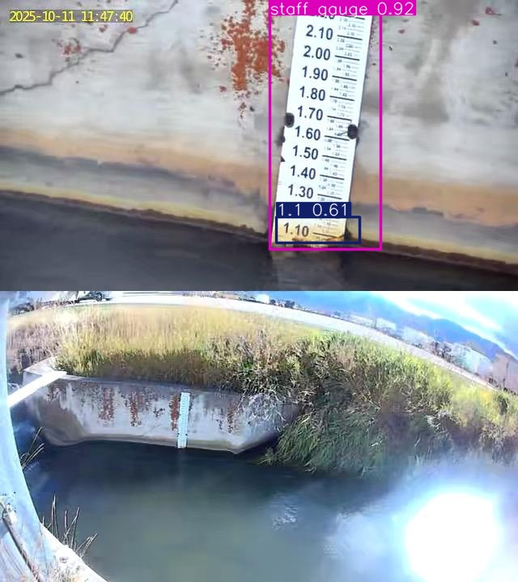
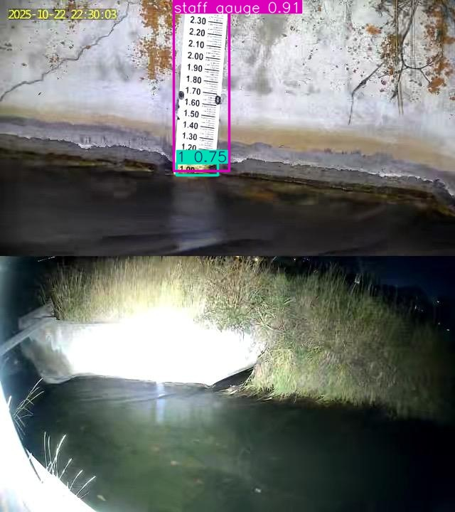
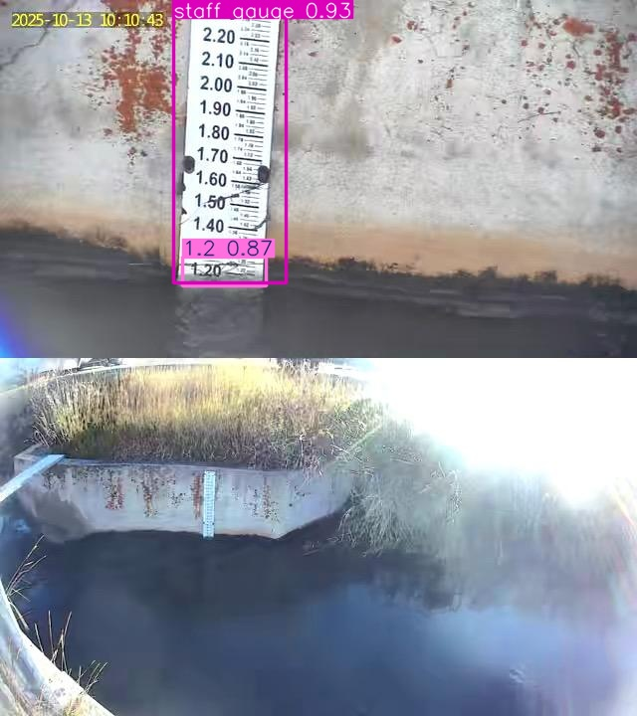
Results (Visual Guage)
Model | Precision | Recall | mAP@0.5 | mAP@0.5–0.95 | Fitness
YOLOv8n (Nano) | 0.685 | 0.806 | 0.822 | 0.420 | 0.42
YOLOv8s (Small) | 0.812 | 0.790 | 0.822 | 0.423 | 0.44
YOLOv8l (Large) | 0.765 | 0.672 | 0.729 | 0.325 | 0.33
Table 5: Results Comparison of All Models
Figure 10: YOLOv8n output
Figure 11: YOLOv8s output
Figure 12: YOLOv8l output
11

Slide 17
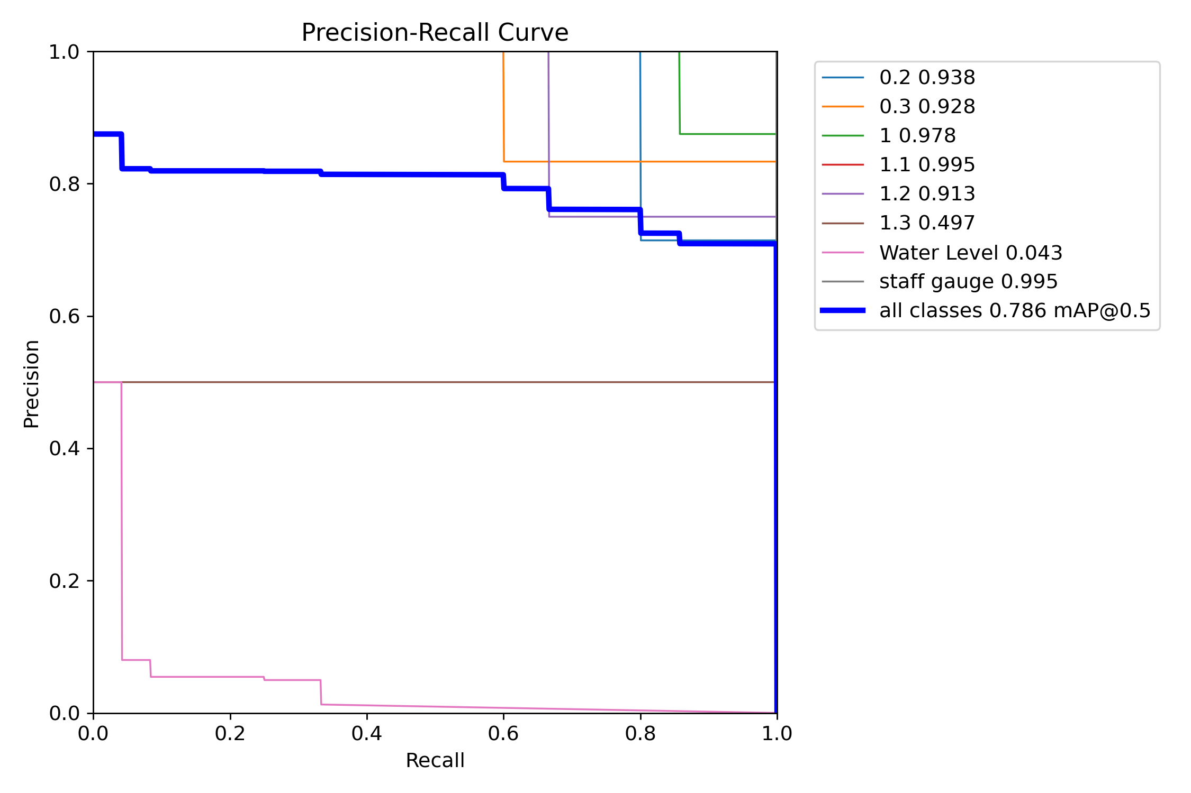
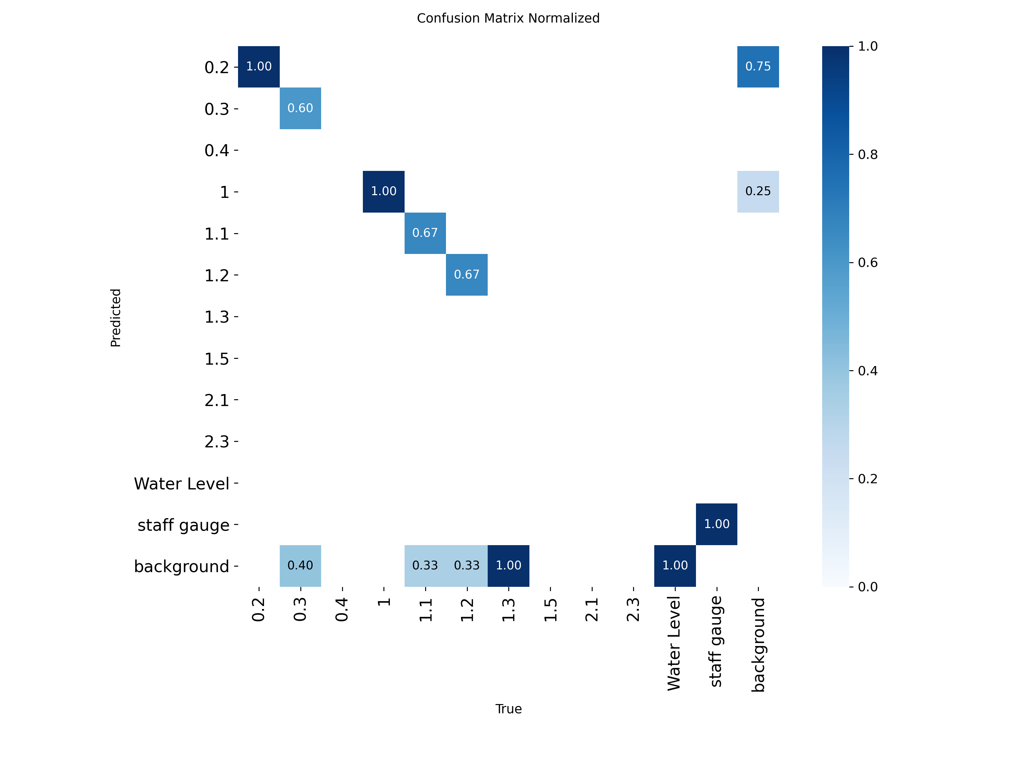
Results - Graphs (Visual Guage)
Figure 13: Precision–Recall Curve (PR Curve)
Displays the trade-off between precision and recall across thresholds.
The model maintains consistently strong performance.
Achieves mAP@0.5 = 0.78, which is strong for this dataset size.
Figure 14: Confusion Matrix (Normalized)
Shows per-class detection accuracy.
Strong diagonal indicates good predictions for most frequent classes.
Lower accuracy on rare labels (Water Level, 1.3, 2.1) reflects insufficient training samples.
11

Slide 18
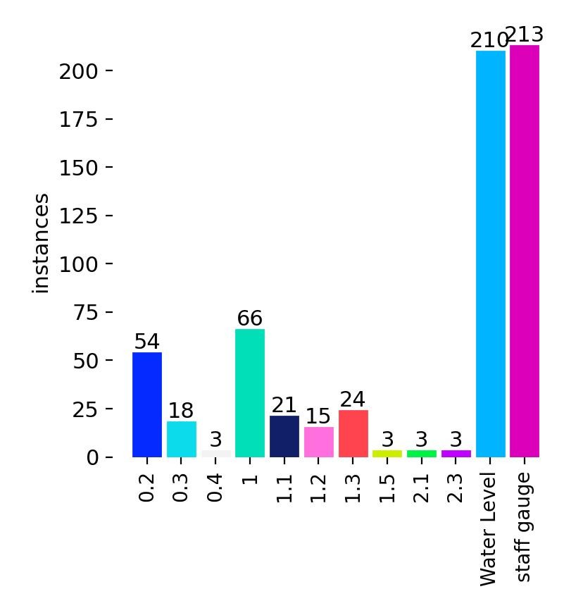
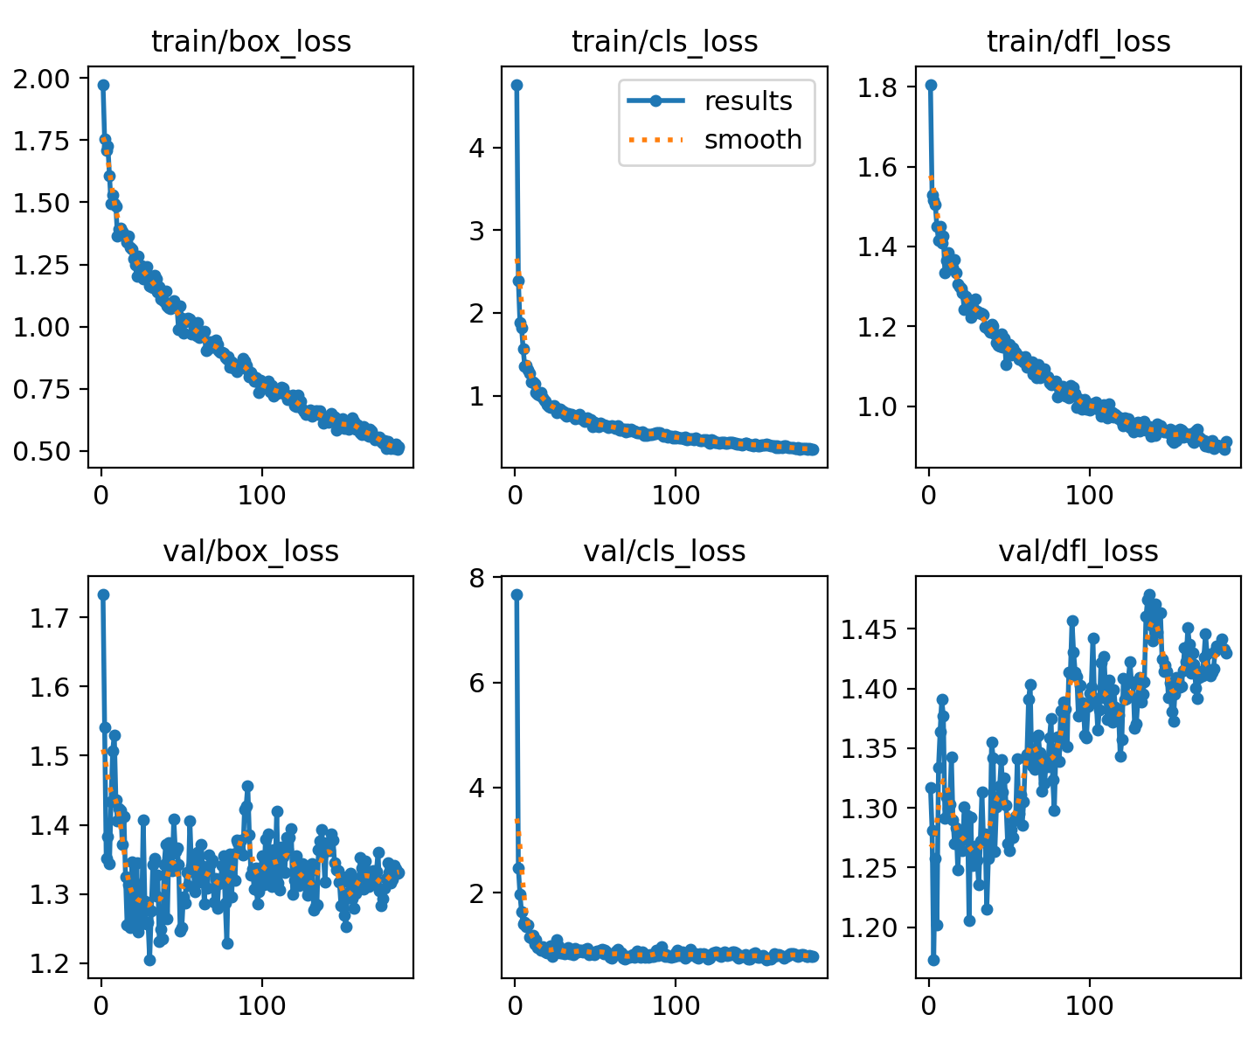
Results (Visual Guage)
Figure 15: Class Distribution
Highlights dataset imbalance — common classes dominate, while rare classes have very few samples
Figure 16: Training vs Validation Loss Curves
Training and validation losses decrease steadily, indicating stable learning.
Small gap between curves shows low overfitting.
11

Slide 19
Conclusion
Demonstrated a camera-based system for operational water-level and discharge monitoring.
Integrated semantic segmentation models to achieve stage predictions.
Showed strong performance across varied environmental and hydrologic conditions, confirming robustness of the approach.
We will apply machine learning algorithms to directly estimate discharge flow.
We will apply develop site-specific, data-driven rating curves for improved discharge prediction.
YOLOv8s selected as final model.
Accurate, robust across all thresholds.
Future improvements:
• Expand dataset, especially rare class images.
• Improve annotation consistency.
• Try segmentation for exact water-line detection.
• Deploy on edge device (Jetson Nano, Raspberry Pi).
15

Slide 20
References
E. Xie, W. Wang, Z. Yu, A. Anandkumar, J. M. Alvarez, and P. Luo, “Segformer:Simple and efficient design for semantic segmentation with transformers,” in Advances in Neural Information Processing Systems(NeurIPS),2021.
A. Kirillov, E. Mintun, N. Ravi, H. Mao, L. Rolland, L. v. d. Gustafson, X. Li, P. Doll´ar, and R. Girshick, “Segment anything,” arXiv preprint arXiv:2304.02643, 2023.
R. M. Hirsch and J. E. Costa, “U.s. stream flow measurement and data dissemination improve,” EOS, Transactions American Geophysical Union, vol. 85, no. 20, pp. 197–203, 2004.
RangeKing. (2023, January 10). Brief summary of YOLOv8 model structure [Issue #189]. GitHub. https://github.com/ultralytics/ultralytics/issues/189?timeline_page=1
Ultralytics. (n.d.). Object Detection — Ultralytics YOLO Docs. Retrieved December 3, 2025, from https://docs.ultralytics.com/tasks/detect/
talhashahzad12345. (n.d.). waterLevelSegmentation [Source code]. GitHub. https://github.com/talhashahzad12345/waterLevelSegmentation
15

Slide 21
Thank You For Your Attention
Any Questions?

